Slide 1
Gradient Descent Algorithm

Slide 2
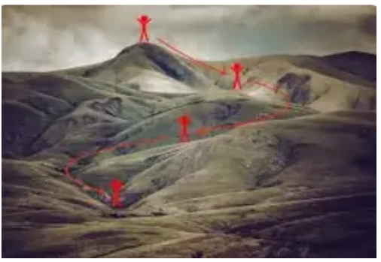
Gradient descent (Basic idea)
Imagine standing on a hill blindfolded and trying to reach the lowest point.
Steps taken
Check slope direction.
Take a small step downhill.
Repeat until you reach the bottom.
The downhill movement = gradient descent.

Slide 3
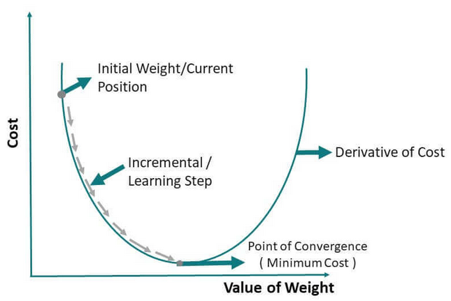
Gradient descent algorithm
Gradient descent is an optimization algorithm used in machine learning to minimize the cost function by iteratively adjusting parameters in the direction of the negative gradient, aiming to find the optimal set of parameters.
The cost function represents the discrepancy between the predicted output of the model and the actual output i.e. the error.
Gradient descent aims to find the parameters that minimize the error and improve the model’s performance.

Slide 4
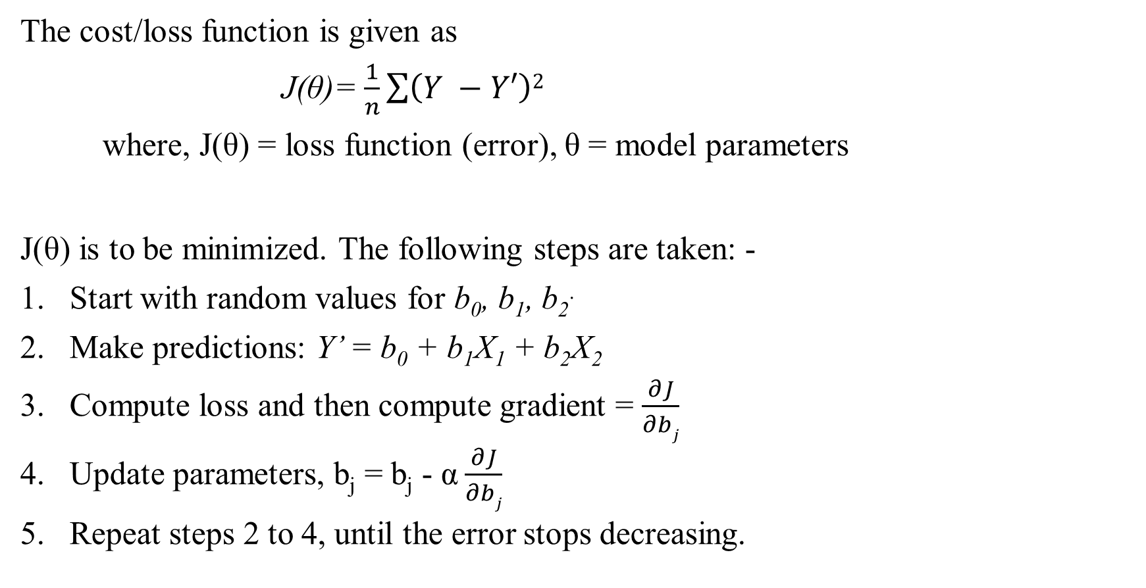
Gradient descent algorithm
The cost/loss function is given as
J(θ)= $\frac{1}{n}\sum{\left(Y −Y′\right)2}$​
where, J(θ) = loss function (error), θ = model parameters
J(θ) is to be minimized. The following steps are taken: -
Start with random values for b₀, b₁, b₂.
Make predictions: Y’ = b₀ + b₁X₁ + b₂X₂
Compute loss and then compute gradient = $\frac{∂J}{∂bj}$
Update parameters, b_{j} = b_{j} - α $\frac{∂J}{∂bj}$
Repeat steps 2 to 4, until the error stops decreasing.

Slide 5
Gradient descent algorithm
The gradient of the cost function, indicates the direction and magnitude of the steepest ascent.
However, since the objective is to minimize the cost function, gradient descent moves in the opposite direction of the gradient, known as the negative gradient direction. (Gradient – uphill, negative gradient – downhill)
The model’s parameters are iteratively updated until the optimal value is found.
Learning rate (α) controls the step size:
Small α – slow learning, large α – unstable convergence.

Slide 6
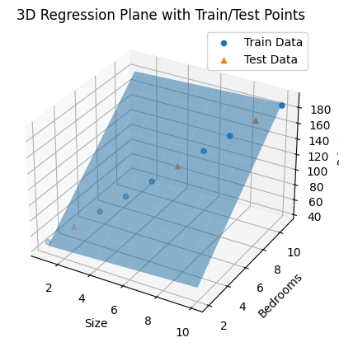

Slide 7
Links
https://medium.com/@yennhi95zz/4-a-beginners-guide-to-gradient-descent-in-machine-learning-773ba7cd3dfe

